Slide 1
Understanding data leakage in cloud from Mobile Apps
-Devin Lilaramani, Shriya Surusani, Anoop Kakkireni.

Slide 2
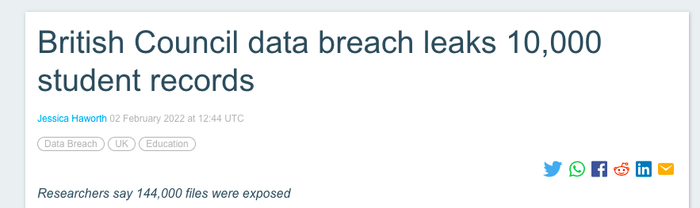
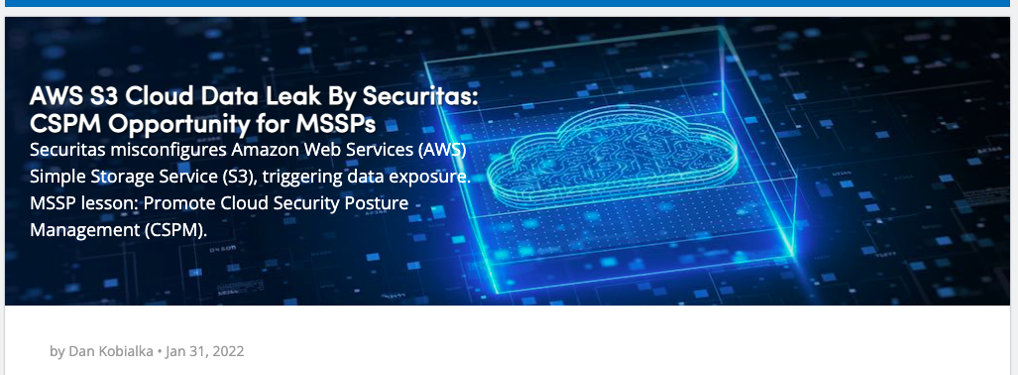

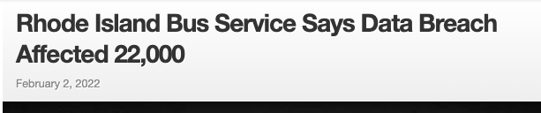
Introduction
Data Leak in today’s world

Slide 3
Background
Using Cloud API’s for mobile app development reduces the effort of building the entire infrastructure from scratch.
Cloud providers now provide mobile back-end as a service (mBaaS)
How to use cloud API’s?
Root key
App Key
Misuse of various keys in authentication due to lack of knowledge.

Slide 4
Problem Statement
Why data leaks occur and how to automatically identify them?
Identification of various keys used by mobile apps
Test the approach of extracting the relevant key strings of our interest
Design a verification method with zero data leakage to validate the possibility of a data leak

Slide 5
Current Progress
Crawled the web for required apks using scrapy.
Checked which cloud Mbaas service each application is using, by going through the specific strings and APIs
Checked for false positives on patched file by running the tool on the apps’ decompiled apks.
Validated the files that are patched by reverse engineering them.

Slide 6
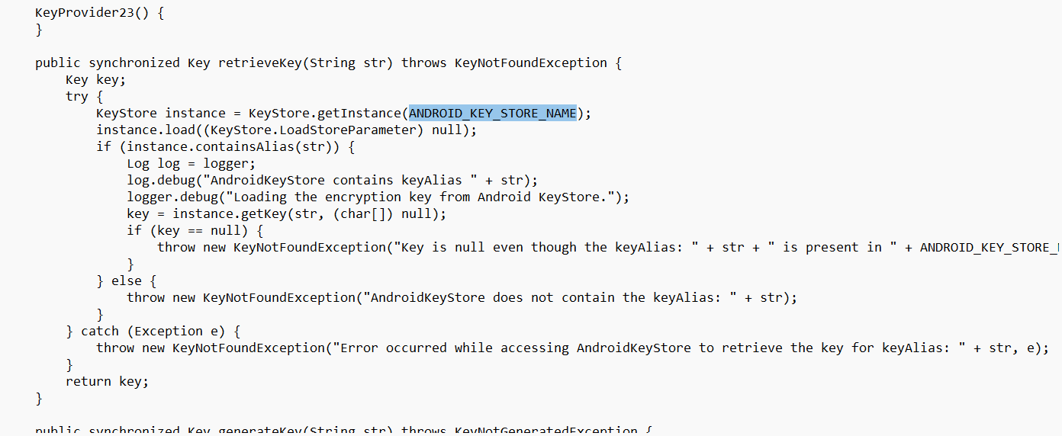
Apps using AWS

Slide 7
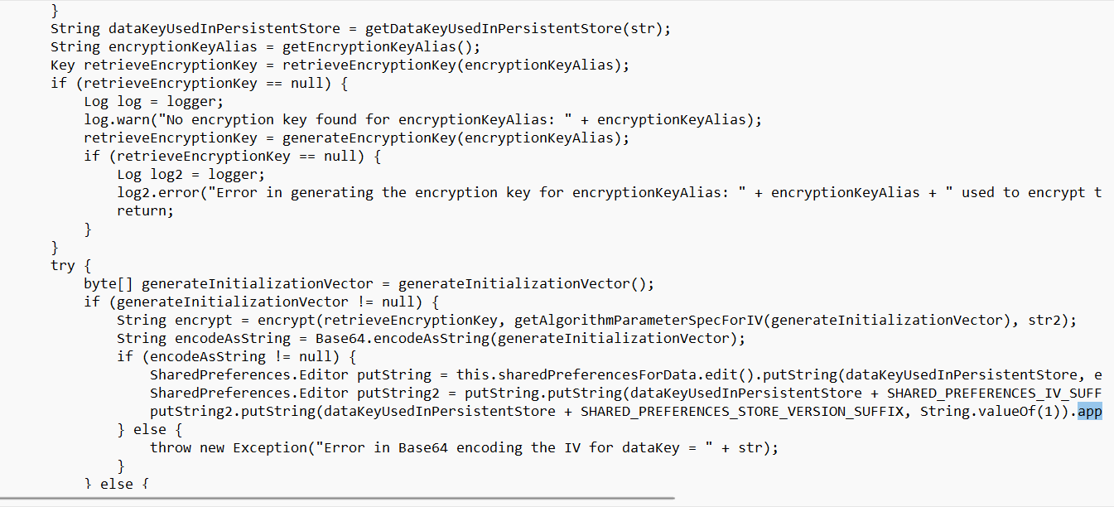

Slide 8
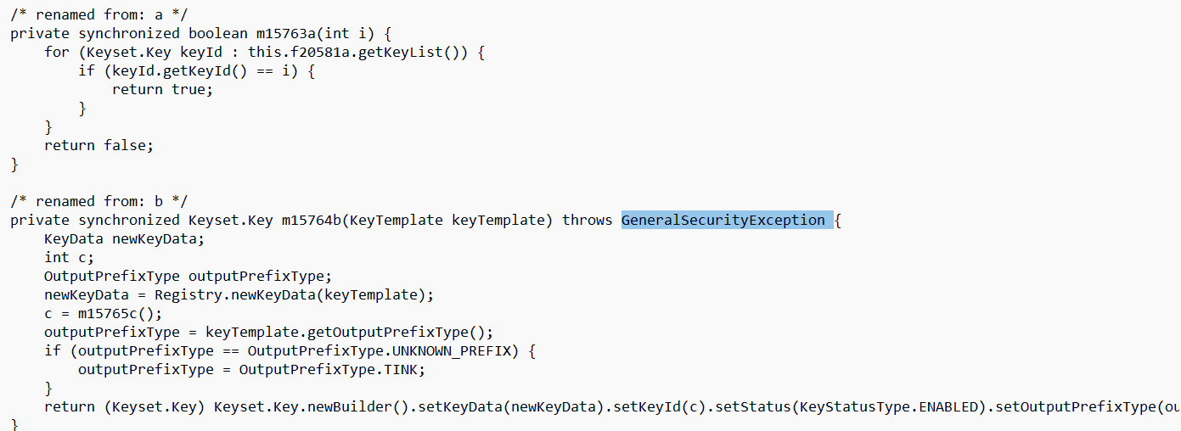
Apps using firebase

Slide 9
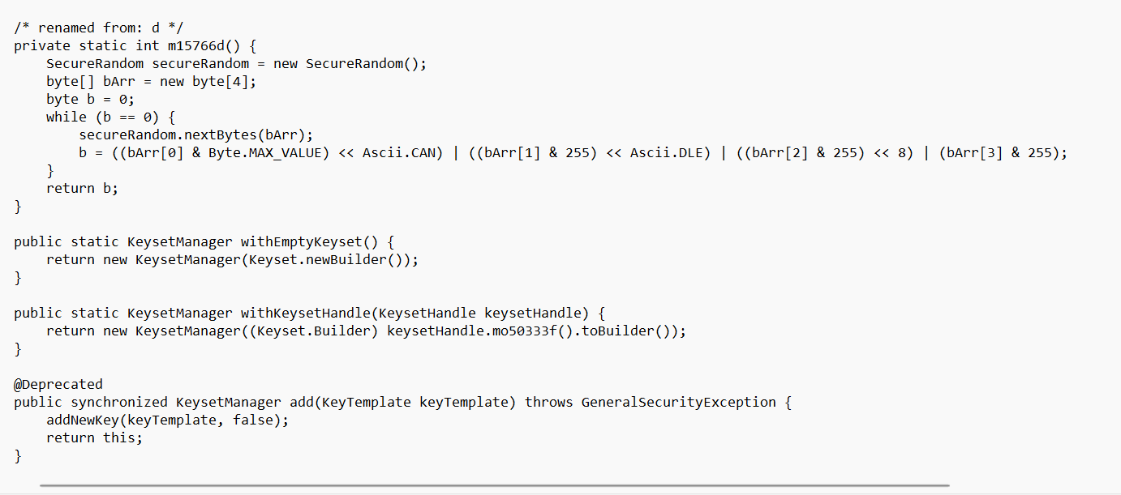

Slide 10
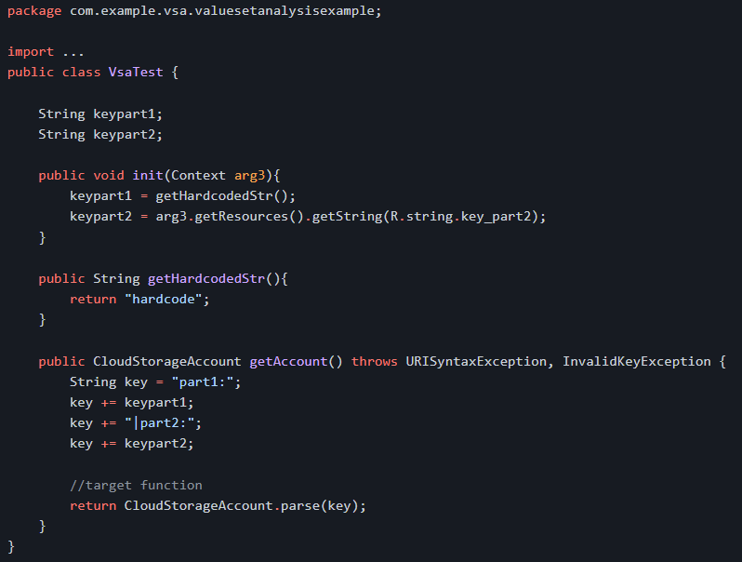
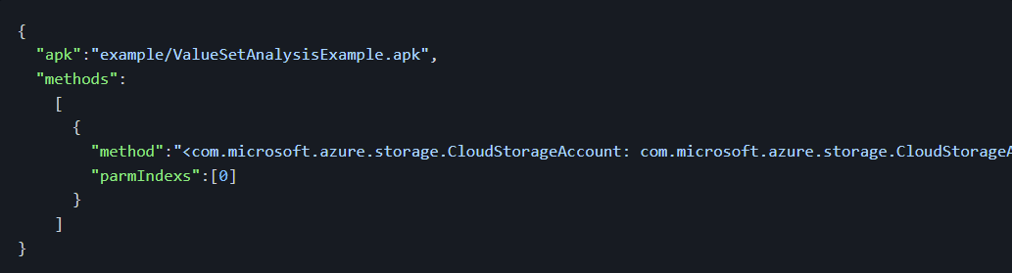
Vulnerable code

Slide 11
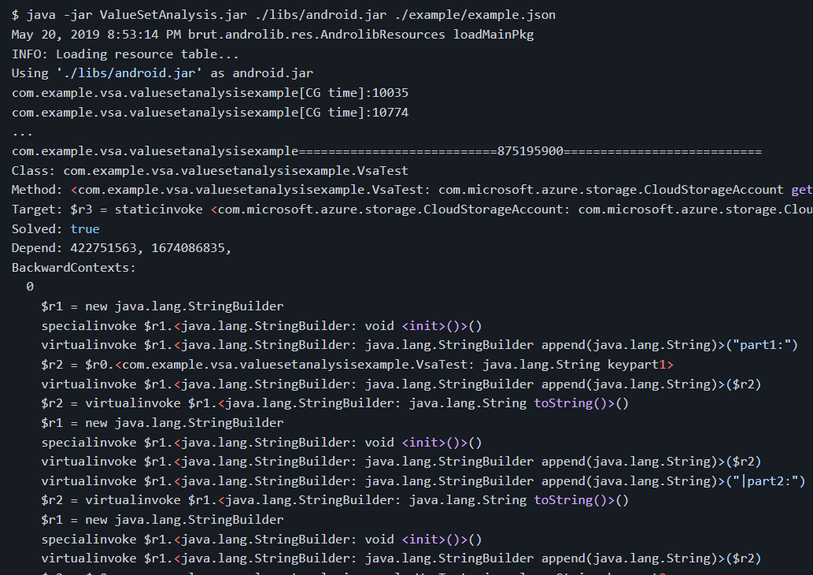
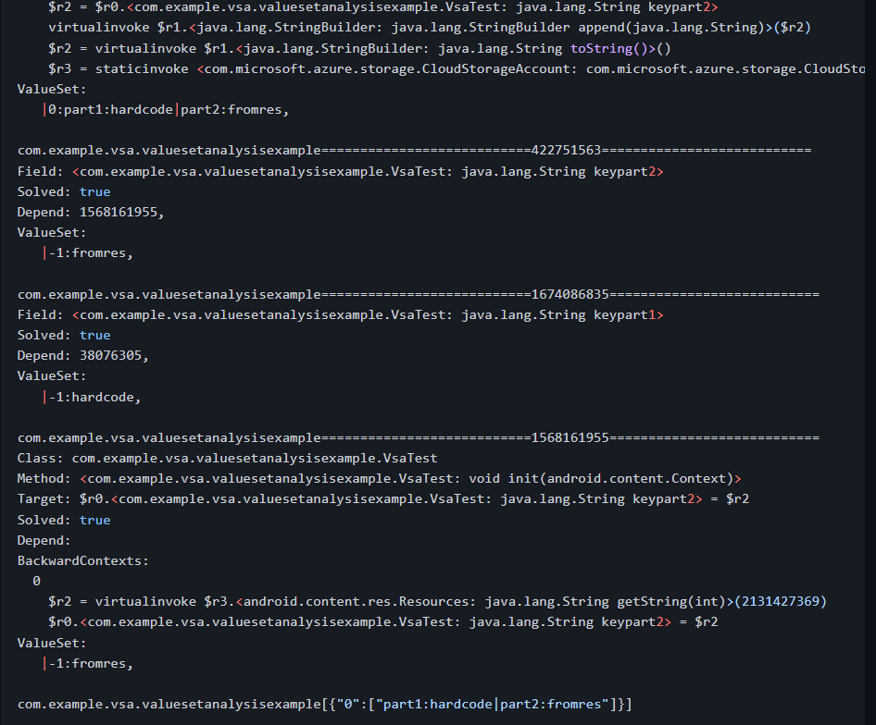
Expected Output

Slide 12
Next Phase
To run the tool on the remaining apps and detect the cloud APIs
Extract and analyze the keys as part of the string value analysis in the output of the code
Determine the type of key extracted based on the differences as per literature (for Azure and Firebase), the differences in cold API responses for AWS

Slide 13
Thankyou (:

